Slide 1
METALS AND NON-METALS

Slide 2
Classification of Elements
Antoine Lavoisier classified elements into metals, non-metals, and metalloids based on their properties.
Metals: Iron, Copper, Gold, Silver, Aluminium, Zinc, Lead.
Non-metals: Hydrogen, Oxygen, Nitrogen, Carbon, Sulphur, Phosphorus, Chlorine, Bromine, Iodine.
Metalloids: Boron, Silicon, Arsenic, Germanium.

Slide 3
Characteristics of Metals
Metals are good conductors of heat and electricity.
All metals are solid at room temperature, except mercury, which is a liquid.
Metals are malleable (can be beaten into thin sheets) and ductile (can be drawn into wires).
Metals have lustre (shine) and can be polished.
Metals are sonorous – they produce a ringing sound when struck.
Metals are electropositive – they tend to lose electrons and form positive ions (cations).

Slide 4
Occurrence of Metals
Metals occur in free state or combined state in nature.
In free state (less reactive): Gold, Silver, Platinum, Mercury.
In combined state (more reactive): Sodium, Potassium, Calcium, Magnesium, Aluminium, Copper.
Metals not affected by air or water remain in free state. Others occur as ores and are extracted by chemical or electrochemical processes.

Slide 5
Physical Properties of Metals
Appearance: All are shiny (metallic lustre). E.g., silver.
Hardness: Most are hard. Sodium and potassium are soft.
Tensile Strength: High; used in construction and machinery.
Malleability: Can be hammered into sheets. E.g., aluminum foil.
Ductility: Can be drawn into wires. E.g., copper, silver.
Conductivity: Good conductors of heat and electricity. Silver is best, followed by copper.
Density: High density (except sodium and potassium).
Sound: Metals are sonorous.

Slide 6
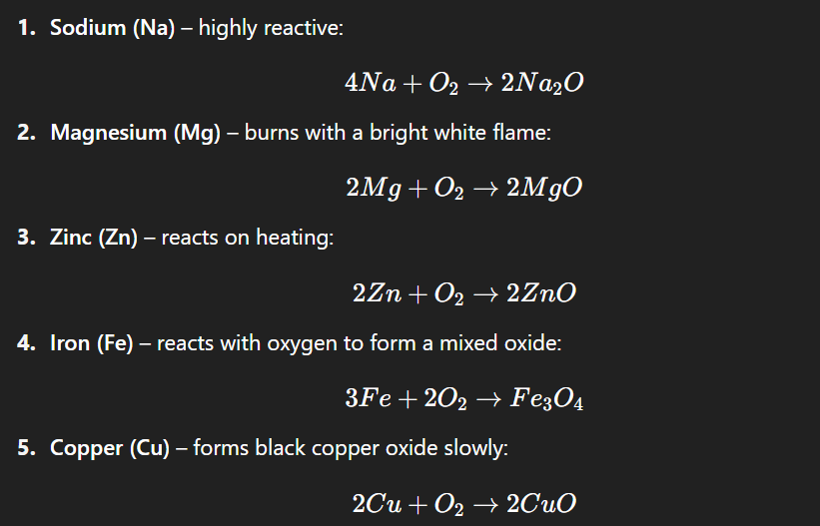
Chemical Properties of Metals – Reactions
Definition: When metals react with oxygen, they form metal oxides. These oxides are usually basic in nature.
Reactivity Order (with Oxygen):
Sodium > Magnesium > Zinc > Iron > Copper

Slide 7
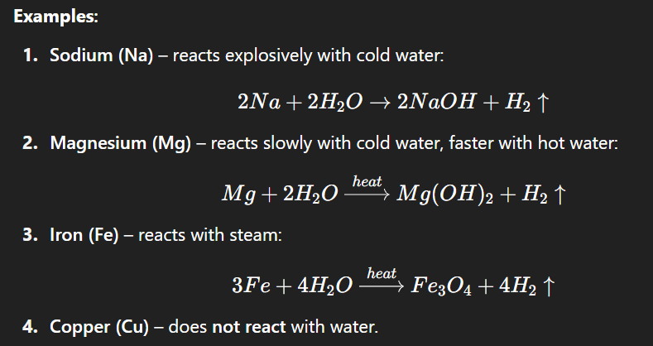
2. Reaction with Water
Definition: Metals react with water to form metal hydroxide (if cold/hot water) or metal oxide (if steam), along with hydrogen gas (H₂).
Reactivity Order (with Water):
Sodium > Magnesium > Iron > Copper

Slide 8
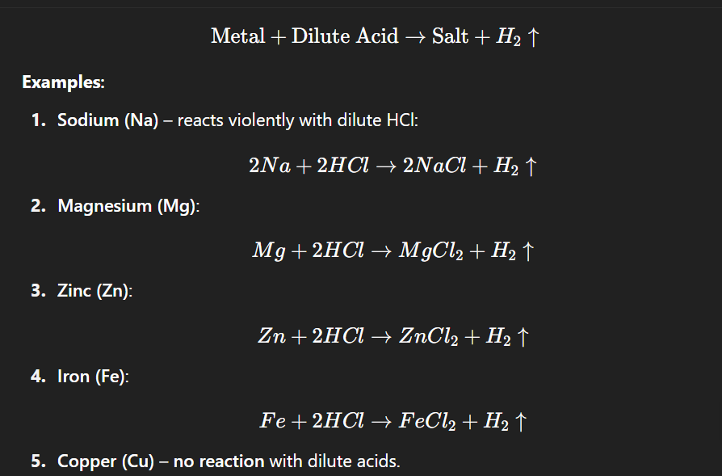
3. Reaction with Acids Definition: Metals react with dilute acids like HCl or H₂SO₄ to form salt and hydrogen gas.
Reactivity Series (with Acids):
Sodium > Magnesium > Zinc > Iron > Copper

Slide 9
Uses of Common Metals
Metal | Main Uses
Iron | Construction, steel, machines
Copper | Electrical wires, utensils
Silver | Jewelry, photography
Gold | Jewelry, decorative
Mercury | Thermometers
Aluminium | Wires, foils, paints, utensils
Lead | Batteries, pipes, X-ray shields

Slide 10
Quick Recap & Quiz
Why is silver used in electrical contacts?
What happens when sodium reacts with water?
Define ductility with an example.
Arrange in increasing reactivity: Copper, Zinc, Magnesium
Name a metal that is liquid at room temperature.

Slide 11
Characteristics of Non-Metals
Mostly found as solids, liquids, or gases.
Non-metals are non-lustrous (except iodine), brittle, and poor conductors.
Non-metals are electronegative – they tend to gain electrons and form anions.
Non-metals have low melting and boiling points (except graphite and diamond).

Slide 12
Occurrence of Non-Metals
Non-metal | Free state | Combined form
Nitrogen | Air (78%) | Proteins, soil nitrates
Oxygen | Air (21%) | Water, oxides
Hydrogen | Water | Organic compounds
Sulphur | Native ores | Sulphates
Phosphorus | Bones | Phosphates
Carbon | Coal, diamond | CO₂, carbohydrates
Extracted from air, ores, or by-products of industry.

Slide 13
Physical Properties of Non-Metals
Physical State: Solids (S, P), liquids (Br₂), gases (H₂, N₂).
Colour: Varied – Sulphur (yellow), Phosphorus (white/red), Bromine (reddish-brown).
Appearance: Dull (except iodine and graphite).
Brittle: Break easily, not malleable or ductile.
Conductivity: Poor conductors (except graphite).
Density: Usually low.
Sound: Non-sonorous.

Slide 14
Chemical Properties of Non-Metals
Electronegative Nature:
Tend to gain electrons to form anions.
Example: Cl + e⁻ → Cl⁻ O + 2e⁻ → O²⁻
Hydrogen Exception: Can act as both electropositive and electronegative.

Slide 15
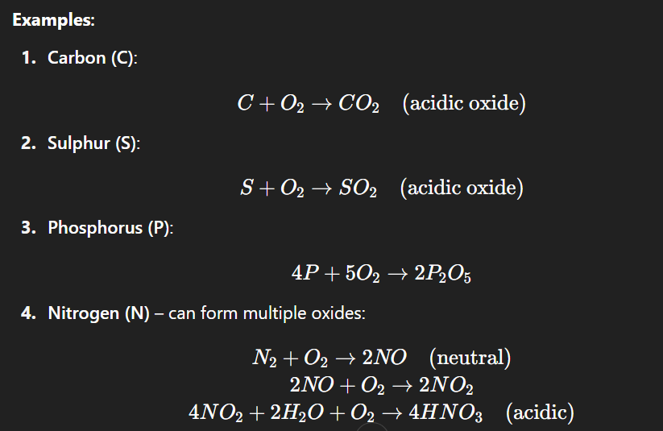
Reactions of Non-Metals
1. Reaction with Oxygen
Definition: Non-metals combine with oxygen to form non-metallic oxides, which are usually acidic in nature.
S+O2​→SO2​(acidic oxide)

Slide 16
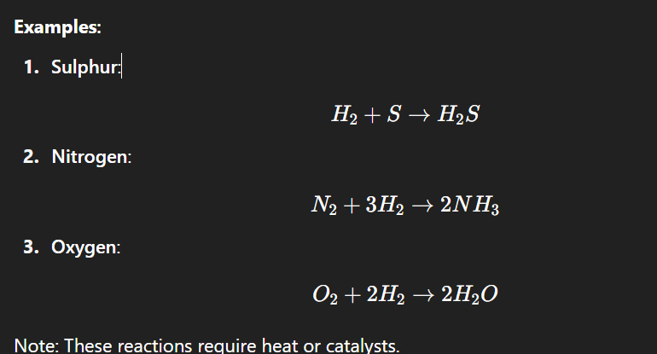
2. Reaction with Hydrogen
Definition: Non-metals react with hydrogen to form covalent compounds known as hydrides.

Slide 17
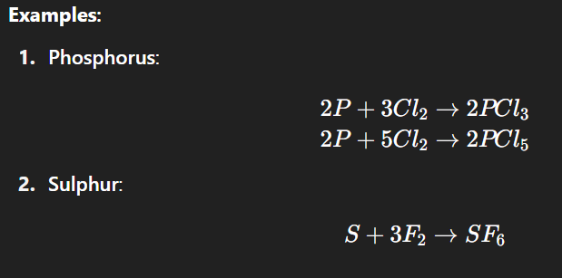
3. Reaction with Halogens
Definition: Non-metals react with halogens (like Cl₂, F₂) to form halides.

Slide 18

4. Reaction with Acids
Most non-metals do not react with dilute acids to release hydrogen gas.
Some may form complex acids like:

Slide 19
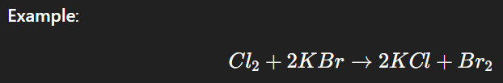
5. Displacement Reactions (Halogen Activity) More reactive non-metals can displace less reactive ones from their compounds.
Explanation:
Chlorine is more reactive than bromine, so it displaces bromine from potassium bromide.

Slide 20
Oxide Nature – Comparison Table
Substance | Reaction in Water | Nature of Oxide
MgO | MgO + H₂O → Mg(OH)₂ | Basic
CO₂ | CO₂ + H₂O → H₂CO₃ | Acidic
SO₂ | SO₂ + H₂O → H₂SO₃ | Acidic
Na₂O | Na₂O + H₂O → 2NaOH | Basic
Litmus Test:
Basic oxides turn red litmus blue.
Acidic oxides turn blue litmus red.

Slide 21
Uses of Non-Metals
Non-metal | Use
Carbon | Fuel, pencils, diamonds
Sulphur | Gunpowder, rubber, sulphuric acid
Phosphorus | Matches, fertilizers
Nitrogen | Ammonia, nitric acid
Chlorine | Sterilisation, bleaching
Hydrogen | Welding, fuels, ammonia synthesis

Slide 22
Recap & Olympiad-Style Questions
Why does graphite conduct electricity but not diamond?
Which non-metal is used in fertilizers and explosives?
What are acidic oxides? Give examples.
Fill in the blank: __________ is the only non-metal that conducts electricity.
State whether the following statement is True or False: “Non-metals are sonorous.”

